Slide 1
Phishing Detection System Through Hybrid Machine Learning Based on URL

Slide 2
ABSTRACT
Phishing attacks are a severe and dangerous cybercrime on the internet.
The project uses a phishing URL-based dataset and applies various machine learning algorithms, including decision tree, linear regression, random forest, naive Bayes, gradient boosting classifier, K-neighbors classifier, support vector classifier, and a hybrid LSD model.
cross-fold validation, and Grid Search Hyperparameter Optimization techniques are used with the proposed LSD model.
Evaluation parameters such as precision, accuracy, recall, F1-score are used to assess the effectiveness of the models.

Slide 3
INTRODUCTION
Phishing is a rising cybersecurity threat where attackers impersonate trusted entities to steal sensitive data, such as usernames, passwords, and financial details.
Effective phishing detection is critical for safeguarding individuals and organizations from potential data breaches and financial losses.
Machine Learning (ML) effectively addresses evolving phishing threats by analyzing large datasets, identifying phishing patterns, offering adaptability, and enhancing detection.
Phishing detection relies on analyzing URLs, as they often reveal malicious intent through signs like misspelled domains or excessive subdomains.
A successful phishing detection system can be integrated into web browsers, email clients, or corporate networks to provide real-time protection.

Slide 4
PROBLEM STATEMENT
Cybercriminals attempt to deceive individuals or organizations into divulging sensitive information, such as passwords and credit card details.
Phishing attacks have become more advanced, making it difficult to detect and prevent them effectively.
Users and organizations are at risk, facing potential data breaches, financial losses, and compromised security due to phishing attacks.
Existing methods and tools for detecting phishing attacks lack the required efficiency and accuracy to combat this growing threat effectively.
There is a critical need for a robust and automated phishing detection system to provide enhanced protection, safeguarding users, organizations, and sensitive data from scams and cybercrimes.

Slide 5
OBJECTIVE
To develop a phishing detection system using a hybrid machine learning approach with a primary focus on URL analysis. Achieve a high degree of accuracy in classifying URLs as legitimate or phishing.
To build multiple machine learning algorithms such as Random Forest, Decision Tree, SVM, Naïve Bayes to enhance the accuracy and robustness of the phishing detection system.
Explore ensemble techniques to further improve model performance.
To develop a user-friendly frontend using Flask for user testing and interaction with authentication.

Slide 6
EXISTING SYSTEM
Existing systems for phishing detection and prevention encompass email and web filters, anti-malware software, user education, browser-based warnings, two-factor authentication, behavioral analysis, machine learning, SIEM solutions, and third-party security services.
DISADVANTAGES
Lack of complete phishing prevention solution in existing studies creates a cybersecurity gap.
Absence of a comprehensive solution leaves users vulnerable to severe consequences.
Traditional methods inadequately detect sophisticated phishing attacks.
Current systems face accuracy and efficiency issues, leading to false results.
Manual identification is slow and struggles to keep up with evolving cyber threats.

Slide 7
LITERATURE SURVEY
AUTHOR | TITLE | METHODOLOGY | PROS | CONS | CONCLUSION | LINK
Y. Lin, R. Liu, D. M. Divakaran, J. Y. Ng, Q. Z. Chan, Y. Lu, Y. Si, F. Zhang, and J. S. Dong | Phishpedia: A hybrid deep learning based approach to visually identify phishing webpages | Phishpedia: A precise logo-based phishing identification system with high accuracy and low runtime impact. | Phishpedia excels in accurate phishing identification by recognizing logos on webpage screenshots and matching variants, without prior training. It outperforms baseline methods and may uncover new phishing sites. | 1. Phishpedia's performance relies on logo availability and quality on webpages. 2. Ongoing updates and maintenance are essential for adapting to evolving phishing tactics. | Phishpedia: A unique deep learning system for precise phishing identification. Excels at logo recognition and matching, outperforming existing methods and uncovering new phishing sites, enhancing phishing attack defense. | https://www.usenix.org/conference/usenixsecurity21/presentation/lin

Slide 8
LITERATURE SURVEY
AUTHOR | TITLE | METHODOLOGY | PROS | CONS | CONCLUSION | LINK
H. Shirazia, K. Haynesb, and I. Raya | Towards Performance of NLP Transformers on URL-Based Phishing Detection for Mobile Devices | It proposes a mobile-friendly phishing detection algorithm. It uses ANNs to analyze URL and HTML features and integrates advanced deep transformers like BERT, ELECTRA, and RoBERTa for learning from URL text. MobileBERT is also assessed for mobile device suitability. | This system swiftly detects phishing URLs using pre-trained transformers, ensuring fast training, easy updates, and safe predictions on mobile devices. It outperforms traditional methods, meeting modern mobile security needs. | 1. Limited to URL detection, may miss complex phishing within legitimate pages. 2. Depends on pre-trained transformers, subject to variations in availability and quality. | Our innovative mobile phishing detection system uses URL text-trained deep transformers for quick training, easy maintenance, real-time mobile deployment, and optimization. It ensures competitive performance, overcoming mobile security challenges efficiently. | https://rayscyberlab.org/wp-content/uploads/2023/04/juspn-v17-i1-pp-35-42.pdf

Slide 9
LITERATURE SURVEY
AUTHOR | TITLE | METHODOLOGY | PROS | CONS | CONCLUSION | LINK
A. Akanchha | Exploring a robust machine learning classifier for detecting phishing domains using SSL certificates | This thesis investigates SSL certificates in phishing sites, analyzes attacker attributes, and develops an auto-detection system based on SSL certificate features. Decision tree ML is selected for its transparency and effectiveness. | The proposed system auto-detects phishing sites through SSL certificate analysis, using the decision tree algorithm for classification. It provides a user-friendly Web API and achieves a high 97% accuracy in identifying phishing. | 1. The system's effectiveness relies on SSL certificate attributes, which could be undermined if attackers develop new methods to mimic genuine certificates. 2. The scalability of the system for managing numerous domains is not extensively discussed. | It introduces an SSL certificate-based phishing detection system with high accuracy and user-friendly Web API. Future considerations should address evolving phishing methods and system updates. | https://dalspace.library.dal.ca/bitstream/handle/10222/78875/Akanchha-Akanchha-MCS-CSCI-April-2020.pdf?sequence=3

Slide 10
LITERATURE SURVEY
AUTHOR | TITLE | METHODOLOGY | PROS | CONS | CONCLUSION | LINK
H. Shahriar and S. Nimmagadda | Network intrusion detection for TCP/IP packets with machine learning techniques. | It covers Network Intrusion Detection Systems (IDS) using machine learning to detect normal and anomalous network activity, employing methods like Gaussian Naive Bayes, logistic regression, Decision Tree, and neural networks for accuracy and efficiency. | The system uses machine learning and classification algorithms like Decision Tree to detect network intrusions across TCP/IP network layers, achieving strong performance on a publicly available dataset. | 1. Evaluation may not reflect real-world conditions or evolving attacks. 2. Algorithm choice not exhaustive; different methods may yield different results. | This chapter applies machine learning to detect network intrusions across TCP/IP layers. Decision Tree performs well with a public dataset, but real-world testing and scalability assessment are needed for validation. | https://link.springer.com/chapter/10.1007/978-3-030-57024-8_10

Slide 11
LITERATURE SURVEY
AUTHOR | TITLE | METHODOLOGY | PROS | CONS | CONCLUSION | LINK
A. K. Dutta | Detecting Phishing Websites Using Machine Learning | It employs Random Forest, a supervised machine learning method, to develop a high-performance system for detecting phishing websites by analyzing and selecting relevant features that characterize phishing sites. | This browser extension, powered by Random Forest machine learning, automatically detects and warns users about phishing sites. Through careful feature selection, it reaches an impressive 98.8% accuracy using 26 key features. | 1. Feature quality impacts adaptability to new phishing tactics. 2. Potential for false results affects user trust. | An intelligent browser extension detects phishing sites with 98.8% accuracy but may have occasional false alerts. It aims to improve online security by countering human vulnerabilities. | https://ieeexplore.ieee.org/document/8769571

Slide 12
LITERATURE SURVEY
This project excels with its hybrid machine learning approach for phishing detection using URL attributes. Multiple models are evaluated, and the hybrid LSD model performs best. Feature selection, cross-fold validation, and parameter optimization contribute to superior results, offering a comprehensive solution against phishing attacks.

Slide 13
PROPOSED SYSTEM
The proposed system uses a hybrid machine learning approach to detect phishing attacks using URL attributes. It uses various machine learning algorithms to prevent attacks and protect users. Cross-fold validation and grid search hyperparameter optimization techniques enhance performance, resulting in improved prediction results.
ADVANTAGES
Combines multiple algorithms for accuracy and fewer false positives.
Adapts to various phishing methods and URL traits.
Optimizes resources for faster, efficient detection.
Effectively thwarts phishing attacks, guarding data.
Cross-fold validation ensures reliability.
Adjusts to new techniques, scalable, cost-effective.

Slide 14
EXTENSION
In enhancing the Phishing Detection System, a Stacking Classifier with RF + MLP using LightGBM exhibits improved performance. Accompanying this, a Flask framework with SQLite integration provides secure signup and signin, optimizing user testing and practical usability for real-world phishing threat assessments.
ADVANTAGES
Stacking Classifier (RF + MLP with LightGBM) outperforms Linear Regression, Random Forest, Gradient Boosting and other classifiers showcasing enhanced efficiency in phishing detection.
The extension exhibits improved performance, indicating increased accuracy in distinguishing phishing threats from legitimate URLs, bolstering defense against cyber threats.
Integrated Flask framework with SQLite ensures secure user testing, optimizing practical usability. The user-friendly interface streamlines signup, signin, and real-world phishing threat assessments for cybersecurity professionals and users.

Slide 15
SOFTWARE / HARDWARE REQUIREMENTS
Hardware Requirements
Operating System : Windows Only
Processor : i5 and above
Ram : 8GB and above
Hard Disk : 25 GB and above
Software Requirements
Software : Anaconda
Primary Language : Python
Frontend Framework : Flask
Back-end Framework : Jupyter Notebook
Database : Sqlite3
Front-End Technologies : HTML, CSS,
JavaScript and
Bootstrap4

Slide 16
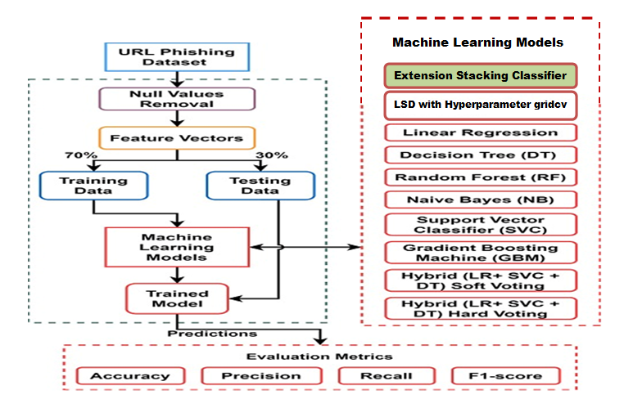
SYSTEM ARCHITECTURE

Slide 17
UML DIAGRAMS

Slide 18
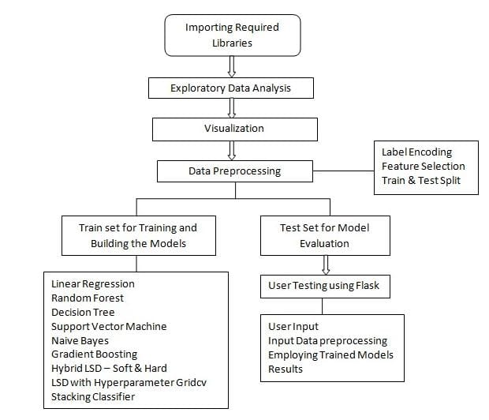
DATA FLOW DIAGRAM

Slide 19
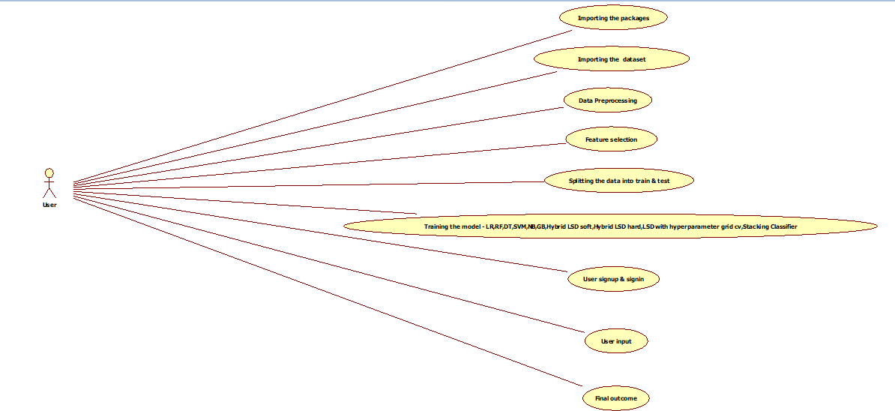
USE CASE DIAGRAM

Slide 20
CLASS DIAGRAM

Slide 21
ACTIVITY DIAGRAM

Slide 22
SEQUENCE DIAGRAM

Slide 23
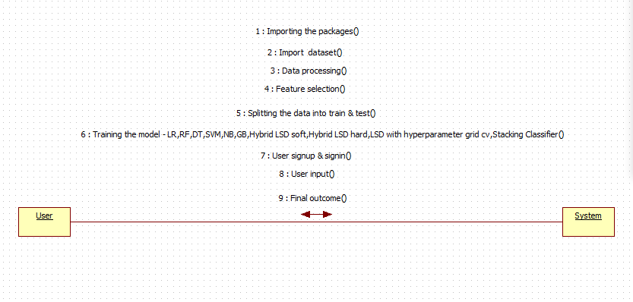
COLLABORATION DIAGRAM

Slide 24
COMPONENT DIAGRAM

Slide 25
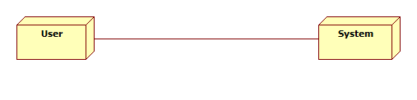
DEPLOYMENT DIAGRAM

Slide 26
WORKING MODULES/ FLOW OF WORK
Importing required Packages
Exploring the dataset - Phishing URL Feature Data
Data Processing - Using Pandas Dataframe
Visualization using seaborn & matplotlib
Label Encoding using Label Encoder
Feature Selection
Train & Test Split
Training and Building the model
As an extension we have applied a hybrid model by combining the predictions of multiple individual models to produce a more robust and accurate final prediction.

Slide 27
WORKING MODULES/ FLOW OF WORK
And we have built front end using flask framework for user testing and with user authentication.
Flask Framework with SQLite for signup and signin
User gives input Url
The given input is preprocessed for prediction
Trained model is used for prediction
Final outcome is displayed through front-end

Slide 28
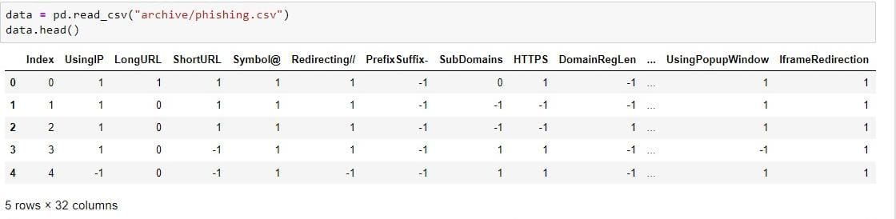
PHISHING DATASET
The dataset used in the proposed system is called the "URL-based phishing dataset" and was extracted from a well-known dataset repository called Kaggle. It consists of phishing and legitimate URLs collected from over 11,000 websites, presented in vector form .

Slide 29
ALGORITHM NAMES
    Linear Regression
    Random Forest
    Decision Tree
    Support Vector Machine
    Naive Bayes
    Gradient Boosting
    Hybrid LSD – Soft
    Hybrid LSD – Hard
    LSD with Hyperparameter gridcv
    Extension Stacking Classifier

Slide 30
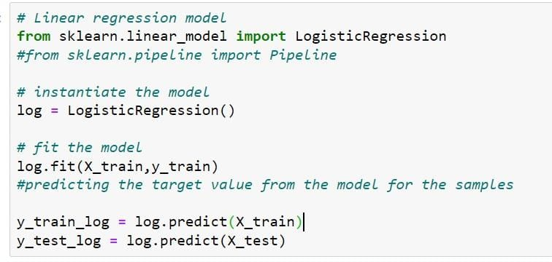
Linear Regression
Logistic Regression is a classification algorithm that predicts the probability of an input belonging to a specific category. It employs the sigmoid function to map the input features to a probability score between 0 and 1, and a threshold is applied to classify the input into one of two or more categories based on this probability. The model learns coefficients during training to best fit the data and make accurate classifications.

Slide 31
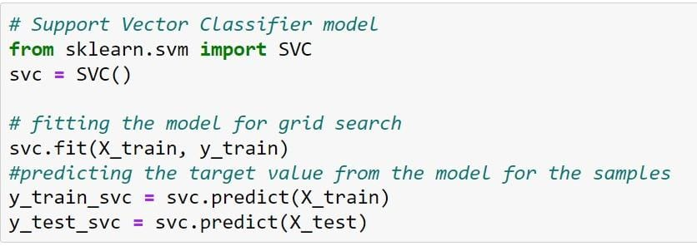
SUPPORT VECTOR CLASSIFIER
A Support Vector Classifier (SVC) is a machine learning model that finds the best possible boundary (hyperplane) to separate different classes of data while maximizing the margin between them. It identifies key support vectors to make accurate classifications, making it effective for both binary and multi-class classification tasks.

Slide 32
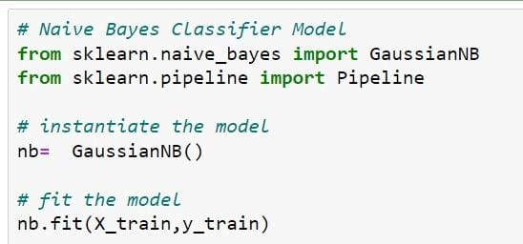
Naive Bayes
Naive Bayes is a probabilistic classification algorithm that works by applying Bayes' theorem with the "naive" assumption of feature independence. It calculates the probability of a data point belonging to a particular class based on the probabilities of its individual features. Naive Bayes is particularly efficient for text classification tasks, spam detection, and other situations where feature independence is a reasonable approximation.

Slide 33
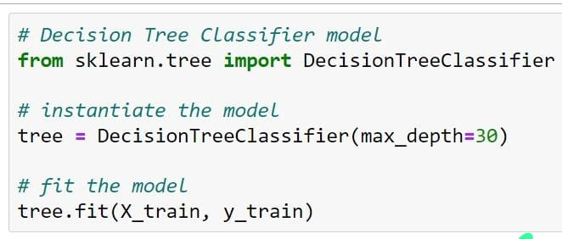
Decision Tree
A Decision Tree is a machine learning model that makes decisions by recursively splitting data into subsets based on the most significant feature, aiming to classify or predict outcomes. It creates a tree-like structure where each node represents a feature and each branch represents a possible decision, making it interpretable and effective for various tasks.

Slide 34
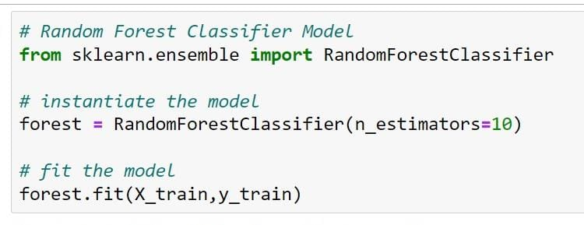
Random Forest
Random Forest is an ensemble learning method that combines multiple decision trees to make predictions. It works by training a collection of decision trees on random subsets of the data and then averaging their predictions. This ensemble approach enhances accuracy, reduces overfitting, and provides robust performance for both classification and regression tasks.

Slide 35
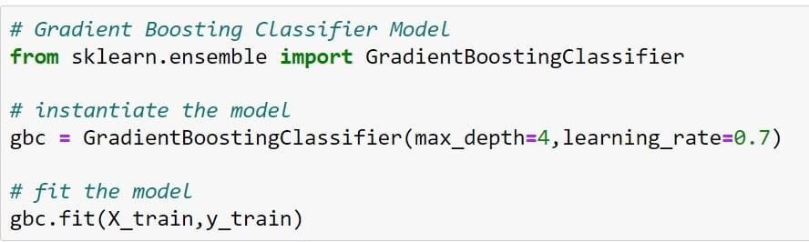
GRADIENT BOOSTING
Gradient Boosting is an ensemble machine learning technique that sequentially builds a predictive model by combining the strengths of multiple weak learners, typically decision trees. It does so by focusing on the errors made by the previous models and adjusting its predictions to reduce those errors, ultimately creating a powerful and accurate predictive model that excels in various tasks, including regression and classification.

Slide 36
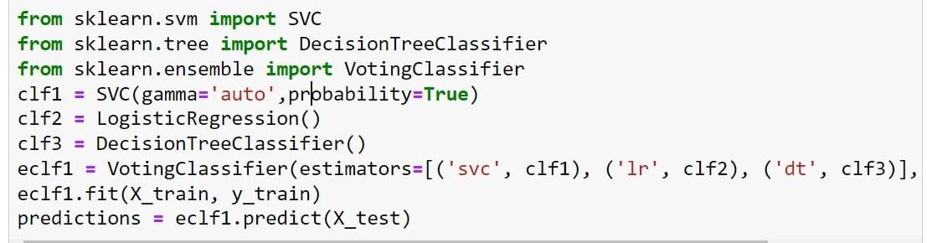
Hybrid LSD (Soft)
The Hybrid LSD (Soft) model combines Logistic Regression, Support Vector Machine, and Decision Tree using soft voting to classify data. It leverages the strengths of each model to make predictions, with the flexibility to handle different types of data and improve accuracy in classification tasks.

Slide 37
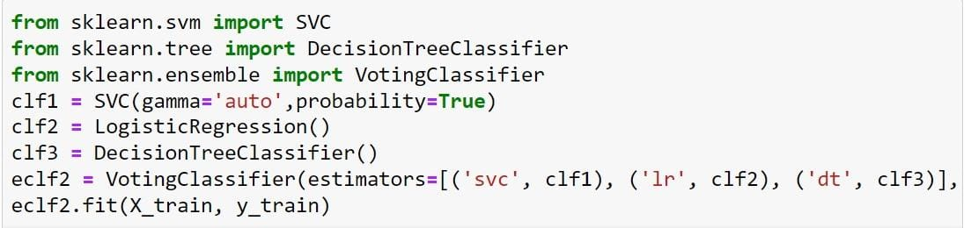
Hybrid LSD (Hard)
The Hybrid LSD (Hard) model combines Logistic Regression, Support Vector Machine, and Decision Tree algorithms with a hard voting technique to make classification decisions. Each component model contributes its prediction, and the final decision is made by majority voting, enhancing accuracy and robustness in various classification tasks.

Slide 38
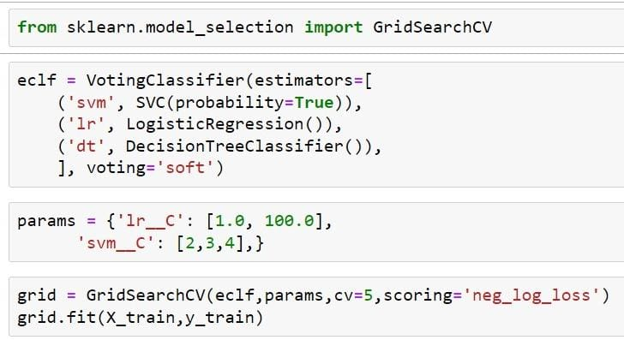
LSD with Hyperparameter GridCV
The LSD (Logistic Regression, Support Vector Machine, Decision Tree) model with Hyperparameter GridCV is a hybrid classification model that combines the strengths of Logistic Regression, Support Vector Machine, and Decision Tree algorithms, enhancing accuracy and efficiency. GridCV systematically searches through hyperparameter combinations to optimize model performance, making it effective in various classification tasks.

Slide 39
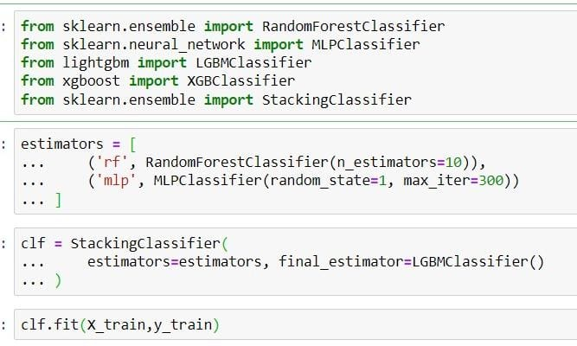
EXTENSION STACKING CLASSIFIER
The project employs a StackingClassifier, an ensemble technique, to combine predictions from RandomForestClassifier and MLPClassifier as base classifiers. It uses LGBMClassifier as a meta-estimator to make the final prediction, extending the project's capabilities for improved classification performance.

Slide 40
PERFORMANCE EVALUATION
 | ML Model | Accuracy | f1_score | Recall | Precision | Specificity
0 | Linear Regression | 0.934 | 0.941 | 0.943 | 0.927 | 0.909
1 | Support Vector Machine | 0.951 | 0.957 | 0.969 | 0.947 | 0.909
2 | Naive Bayes Classifier | 0.605 | 0.454 | 0.292 | 0.997 | 0.909
3 | Decision Tree | 0.957 | 0.962 | 0.991 | 0.993 | 0.909
4 | Random Forest | 0.969 | 0.972 | 0.993 | 0.990 | 0.909
5 | Gradient Boosting Classifier | 0.974 | 0.977 | 0.994 | 0.986 | 0.909
6 | Hybrid LSD - SOFT | 0.959 | 0.964 | 0.977 | 0.965 | 0.909
7 | Hybrid LSD - HARD | 0.950 | 0.956 | 0.967 | 0.945 | 0.909
8 | Hybrid LSD | 1.000 | 1.000 | 1.000 | 1.000 | 0.426
9 | Stacking Classifier | 1.000 | 1.000 | 1.000 | 1.000 | 0.426

Slide 41
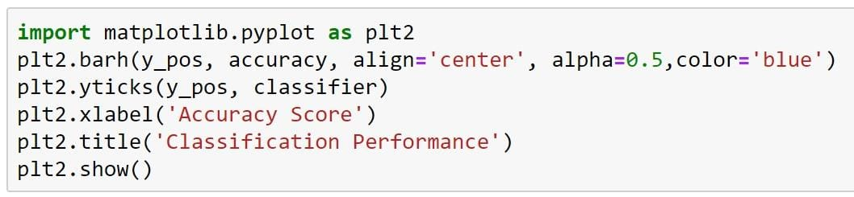
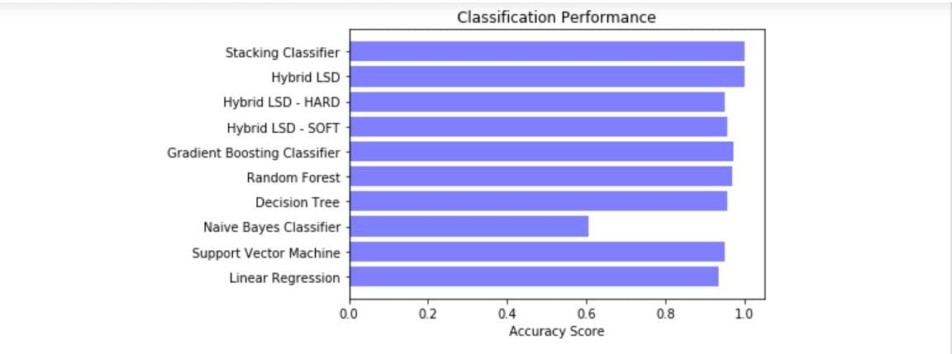
ACCURACY COMPARISON GRAPH

Slide 42
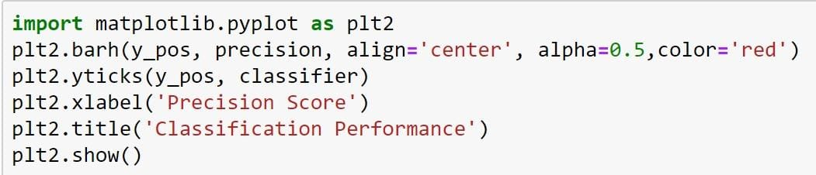
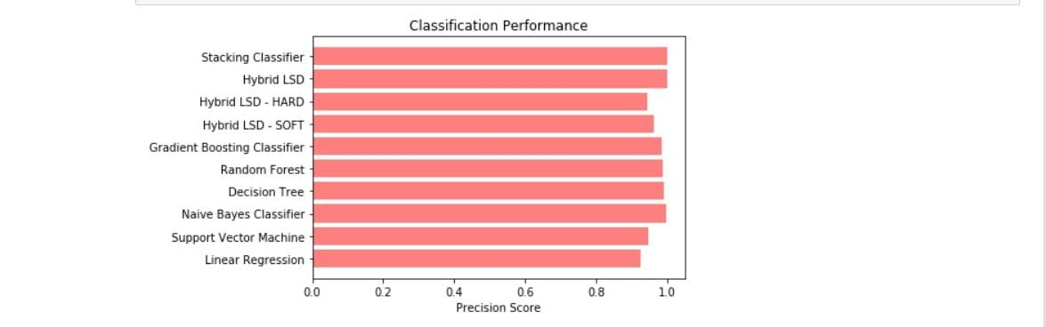
PRECISION COMPARISON GRAPH

Slide 43
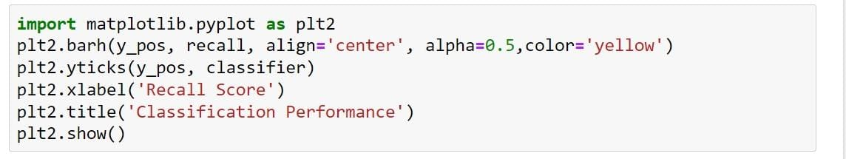
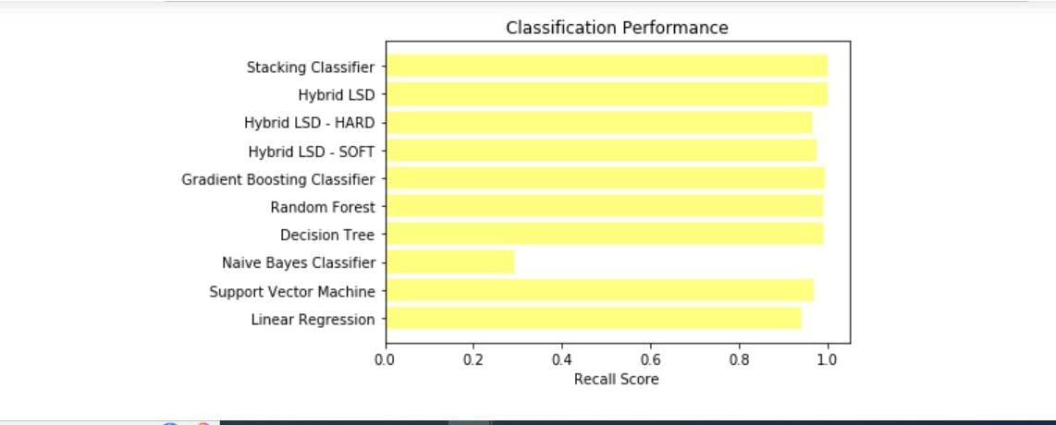
RECALL COMPARISON GRAPH

Slide 44
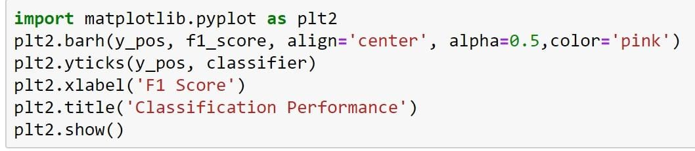
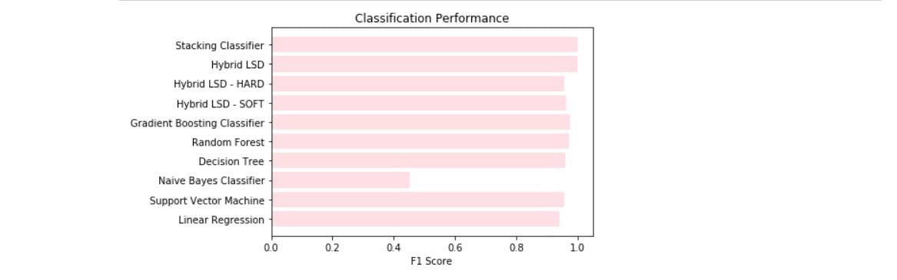
F1 SCORE COMPARISON GRAPH

Slide 45
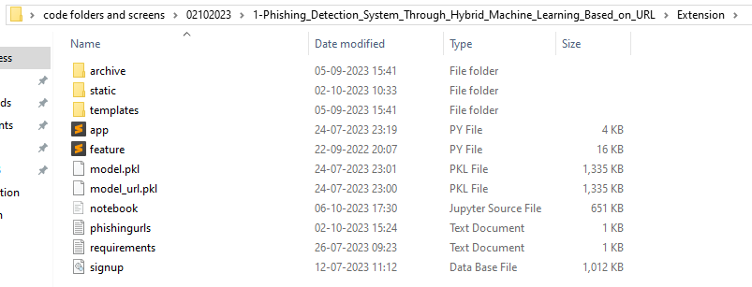
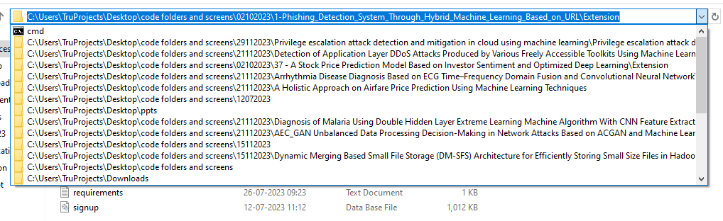
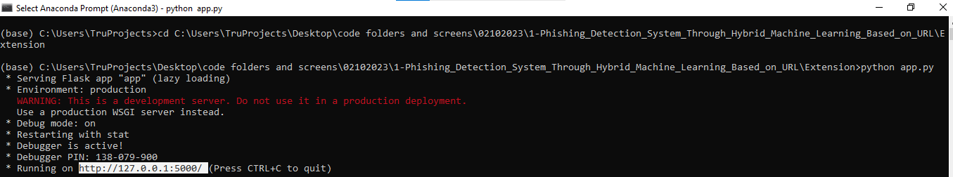
EXECUTION
STEP1
STEP2
STEP3

Slide 46
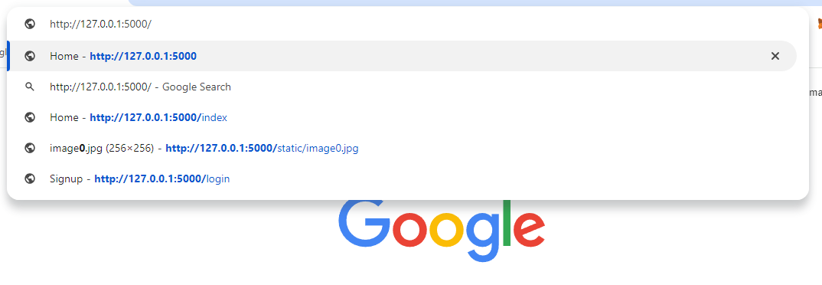

EXECUTION
STEP4
STEP5

Slide 47


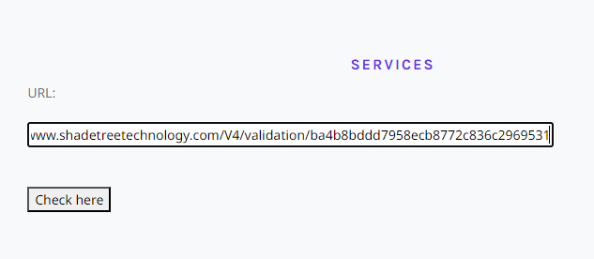
EXECUTION
STEP6
STEP7
STEP8

Slide 48
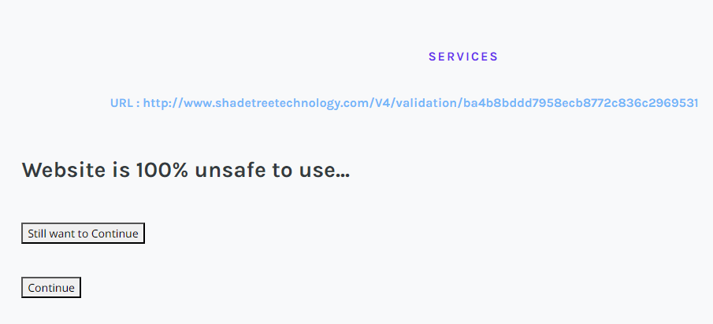

EXECUTION
STEP9
STEP10

Slide 49

EXECUTION
STEP11

Slide 50
CONCLUSION
The project utilized a hybrid machine learning approach, focusing on URL attributes for phishing detection.
Various machine learning models, including decision tree, random forest, support vector classifier, LSD hard and soft etc, were employed to enhance accuracy and efficiency.
An extension stacking classifier was chosen for its exceptional accuracy and F-score, significantly improving the effectiveness of the system.
And our integration of Flask with SQLite ensures a seamless and secure front-end for user testing
The project's comprehensive phishing detection system addresses a critical cybersecurity challenge, offering protection against severe phishing attacks.

Slide 51
FUTURE SCOPE
Project can expand by exploring additional algorithms and techniques to boost phishing detection accuracy and efficiency.
Extend the project to include real-time monitoring for evolving cyber threats.
Evaluate the model's effectiveness on a larger, diverse dataset for increased robustness.
Consider integrating user behavior and network traffic analysis to enhance detection capabilities.
The model can be extended to detect other cybercrimes like malware attacks and social engineering.

Slide 52
REFERENCES
Y. Lin, R. Liu, D. M. Divakaran, J. Y. Ng, Q. Z. Chan, Y. Lu, Y. Si, F. Zhang, and J. S. Dong, ‘‘Phishpedia: A hybrid deep learning based approach to visually identify phishing webpages,’’ in Proc. 30th USENIX Secur. Symp. (USENIX Security), 2021, pp. 3793–3810.
H. Shirazia, K. Haynesb, and I. Raya, ‘‘Towards performance of NLP transformers on URL-based phishing detection for mobile devices,’’ Int. Assoc. Sharing Knowl. Sustainability (IASKS), Tech. Rep., 2022.
A. Akanchha, ‘‘Exploring a robust machine learning classifier for detecting phishing domains using SSL certificates,’’ Fac. Comput. Sci., Dalhousie Univ., Halifax, NS, Canada, Tech. Rep. 10222/78875, 2020.
H. Shahriar and S. Nimmagadda, ‘‘Network intrusion detection for TCP/IP packets with machine learning techniques,’’ in Machine Intelligence and Big Data Analytics for Cybersecurity Applications. Cham, Switzerland: Springer, 2020, pp. 231–247.
A. K. Dutta, ‘‘Detecting phishing websites using machine learning technique,’’ PLoS ONE, vol. 16, no. 10, Oct. 2021, Art. no. e0258361.

